Slide 1
Wrap UP
Joann O’Brien
July 24, 2014

Slide 2
TAW Statistics
14 Chartered Projects, 9 working in Agile Methodologies
134 Sessions
133 Registered Delegates, >30% Operators
5 Catalyst Projects Kickoff
9 Catalysts Presented to SAS
Geographic Splits
Asia/Pacific 17%
Eastern Europe 4%
North America 46%
Western Europe/Scandinavia 28%
South America 1%
Other 4%

Slide 3
Where Slides are on the WEB?
HTTP://WWW.TMFORUM.ORG/Community
Collaboration Program Centre -> Project Workspace - > Documents -> Team Action Week -> TAW Morristown 2014 -> Wrap Up Presentations
https://collab.tmforum.org/sf/docman/do/listDocuments/projects.collaboration_program_centre/docman.root.team_action_week.taw_morristown_2014.wrap_up_presentations

Slide 4
Information Framework Two Minute Synopsis Orange, Amdocs Huawei, Infonova, Ericsson
Cecile Ludwichowski, Josh Salomon
July 21, 2014

Slide 5
Quote
“We need to add examples, to further explain the use of the SID”

Slide 6
Project Title
 | Advance the information framework to support new requirements
 | Review contributions On going work (Metrics, EP) Joint meeting with C&B
 | Reviewed multiple C&B related contributions and agreed on future work plan with C&B team Billing Account Customer Account Balance NFV billing
Project
Objectives
Action Week Objectives
Accomplishment

Slide 7
Top 3 Fx Deliverables
 | Deliverable | Delivery Date
1 | Prioritized list of items on reviewing and aligning Engaged Party domain across SID and eTOM Start analyzing the EP ABEs to enhance/refine their initial (preliminary) content | Done Fx 14.5 (15.0)
2 | Adding examples on how to instantiate the metrics model for real world scenarios | Fx 14.5
3 | Embed contributions into next Frameworx version | Fx14.5
 | Always ☺
Additional help needed?

Slide 8
Application Framework Ericsson, Orange
July 24, 2014

Slide 9
Application Framework
 | Create a functional de-composition out of the applications in Application Framework
 | Establish Guiding principles for Phase 2 of the func.de-comp. Commencement of Phase 2 work Plan of actions for Rel.14.5
 | > Objectives fulfilled
Project
Objectives
Action Week Objectives
Accomplishment

Slide 10
Top 3 Fx Deliverables
 | Deliverable | Delivery Date
1 | Phase 2 function de-composition of functions in two AF domains. | Rel. 14.5
2 | Mapping of Functions to BPF within a specified Context to exemplify possible usage of functions | Rel. 14.5
3
 | Participants, Participants, Participants,
Additional help needed?

Slide 11
Business Process Framework Ericsson, Orange, Huawei, Infonova, Amdocs,
Avi Talmor
July 24, 2014

Slide 12
Quote
Life is like a box of chocolates..
Forrest Gump

Slide 13
Application Framework
 | Evolve BPF for Digital ecosystem Contribution and maintenance support
 | Enhance Engaged Party Decomposition Explore suggested structural changes Set goals for upcoming release
 | Progressed de-composition Identified needed additions and amendments in the structural change
Project
Objectives
Action Week Objectives
Accomplishment

Slide 14
Top 3 Fx Deliverables
 | Deliverable | Delivery Date
1 | Full de-composition of the Engaged Party domain | Rel. 14.5
2 | Introduction of structural changes | Rel. 14.5
3
 | Participants, Participants, Participants,
Additional help needed?

Slide 15
Integration Program Two Minute Synopsis Participating Companies
Stephen Fratini
July 21, 2014

Slide 16
Quote
“We should have the same approach for service problems and resource alarms.”
Yuval Stein

Slide 17
Project Title
 | Define industrial strength interfaces for systems integration
 | Further work on carrier Ethernet and Service Chaining (VNF FG) operations flows (update working document) Joint meeting and further work planning with the MEF Joint Meeting and further work planning with ZOOM team Further MTNM work L3 VPN
 | See objectives (all of which were met) Also note that Augie Jagau will represents TIP at the MEF meetings next week
Project
Objectives
Action Week Objectives
Accomplish-
ments

Slide 18
Top 3 Fx Deliverables
 | Deliverable | Delivery Date
1 | Interface specifications for Customer Problem Management, ESEC, MTNM, PM, Inventory, Ordering and Provisioning
2 | Input to ZOOM deliverable on interface support for ETSI NFV Position paper on YANG
3 | New work on Change Management, and Test and Diagnostics
 | Interface modelers Interface development tools Systems Integration Marketing and product management assistance
Additional help needed?

Slide 19
Internet of Things Two Minute Synopsis Participating Companies
Presenter
July 21, 2014

Slide 20
Quote
“A potential name for the IoT “common/horizontal” project should be “IHOP” (the name of a US Pancake house)”

Slide 21
New this week - Internet of Things
 | Develop a consistent framework for enabling end to end management of IoT services across multiple vertical industries based on common user stories, identifying common patterns
 | Will address IoT architecture and development of cross industry patterns Strategic Goals: Gap analysis and artifacts roadmap IoT architecture roadmap Liaison with key industry groups Security/Privacy working group cross team meetings
 | Reviewed – IoT Layered Ecosystem - what are the dialogues across layers • Identify key patterns - Discuss key touchpoints Vertical Project Priorities Common Business Canvas - assignments Common Architecture - assignments IoT Security/Privacy – cross team meetings Common User stories - assignments
Project
Objectives
Action Week Objectives
Accomplishment

Slide 22
Top 3 Deliverables
 | Deliverable | Delivery Date
1 | Charter for IoT “cross industry” | Aug 8
2 | IoT Enterprise Framework Tool Kit V1 (combine common Industry/ODE artifacts) | Oct 30
3
 | Industry experts – Verticals (transportation, smart city) Industry liaisons User Story collection/analysis Enterprise Architecture
Additional help needed?

Slide 23
Digital Health Catalyst Two Minute Synopsis Ericsson, BaseN, Verizon, ISPM,
Presenter
July 21, 2014

Slide 24
Project Title
 | One sentence: To create a working demonstration of chronic disease management platform for health client
 | Fill in the gaps in existing Catalyst Identify use cases to be integrated with ACO or other health client
 | Workplan for Catalyst Call with actual ACO to understand pain points
Project
Objectives
Action Week Objectives
Accomplishment

Slide 25
Top 3 Fx Deliverables
 | Deliverable | Delivery Date
1 | Filling in gaps of existing Catalyst | San Jose
2 | Identification of several use cases and research, begin integrating with | San Jose
3 | Live demo of project that can work with real health client | Nice
Additional help needed?

Slide 26
OD API - Open Digital Business Scenarios and Use Cases Two Minute Synopsis
Johannes Minnaar & Pierre Gauthier
July 24, 2014

Slide 27
Quote
“Any simple problem can be made unsolvable if enough meetings are held to discuss it”

Slide 28
Digital Business Scenarios and Use Cases
 | Open Digital API – Provide Business View of API usage as they relate to e2e scenario
 | Review/Finalize Present OD API Deliverables Present OD API BizS and UC
 | Added Onboarding Process Relation to Customer Journey Evolve Trouble to Resolve into wider Service Management (SQM/SMI) Received 7 x API Ecosystem Requirements from DSRA + Others E.g.- Resource Ordering Federate (Identity / Security) Authentication/Authorization/Identity/Profiling/Security Future Long Term Scenario to be detailed : Smart Grid, eHealth, NFV
Project
Objectives
Action Week Objectives
Where do you need help?

Slide 29
Catalog Management Two Minute Synopsis Ericsson, Cisco, Sigma Systems
Elaine Haher
July 21, 2014

Slide 30
Quote
“There will be billions of Digital Service Providers and many Digital Ecosystems or brokers”

Slide 31
Catalog Management
 | Lifecycle Management The Catalog Management team will be focusing on PLM for management of both internal catalog entities and for transactions across a rich value fabric to enable operations between operators, partners and suppliers. Catalog to Catalog Integration REST API Reference Architecture and Guidebook
 | Value Fabric Lifecycle management: Team Review of PLM Requirements from Catalog Management Version 2.0 (JIRA list) Define the business problems Determine study objectives Determine tool to use to solve the business problem
 | Business problems – version mgt, lifecycle mgt and retirement of offers, backward compatibility, notifications Further define partner onboarding, trader functions to replace retired partners Catalog Mgt API spec was reviewed; to be utilized to update the catalog to catalog guidebook for PLM information The guidebook will be made available to github after review.
Project
Objectives
Action Week Objectives
Accomplishment

Slide 32
Top 3 Fx Deliverables
 | Deliverable | Delivery Date
1 | Update guidebook with PLM features and use case and deliver on github | Sept 2014
2 | Catalog Mgt API version 3 | Nov, 2014
3
Additional help needed?

Slide 33
NFV/Zoom Two Minute Synopsis Participating Companies
Presenter
July 21, 2014

Slide 34
Quote
“The solution is simple: just find a smarter customer”

Slide 35
 | Increase time-to-market and business agility, while lowering OpEx, in a controlled, “evolved revolution” manner
 | Progress understanding of ZOOM to increase involvement Progress content, specifically user stories, model, and architecture Progress pragmatic outputs (e.g., links to DD Catalysts)
 | User stories advanced; multiple contributions integrated and enhanced NFV readiness and procurement defined Model and architecture are strongly related, and need to be advanced in a coordinated manner to be effective Security work kicked off
Project
Objectives
Action Week Objectives
Accomplishment

Slide 36
Top 3 Fx Deliverables
 | Deliverable | Delivery Date
1 | User Stories enhancement and delivery | Sep 2014
2 | Joint model and architecture iteration (includes policy management) | October 2014
3 | Outreach, dissemination, and SDO coordination | October 2014
` | MORE RESOURCES | N/A
Additional help needed?

Slide 37
Security & Privacy
Chris Stock
July 24, 2014

Slide 38
Yet another security meeting!

Slide 39
Security & Privacy
Program Objectives | Embed security and privacy best practice/guidance in all that we do
Action Week Objectives | Kick off 2/3 security/privacy projects across all programs
 | IoT Security Insertion into Fx Security Compliance Automation NFV E2E Sy Mgt ODE (Fed ID Mgt) Big Data Fraud others
Accomplishment

Slide 40
Top 3 Fx Deliverables
 | Deliverable | Delivery Date
1 | Initial phase – Security/privacy into Frameworx
2 | Best practice/guidance on IOT security
3 | tbd
 | Support from projects
Additional help needed?

Slide 41
Data Analytics Two Minute Synopsis Orange, PLDT, China Mobile, BAE Systems, Oracle, Verizon, Cliintel, TEOCO, Ericsson, Parstream, CSG, Huawei, ESRI, cVidya
Rebecca Sendel
July 24, 2014

Slide 42
Quote
“Propensity to Buy? Oh, you mean Gullibility Index!”

Slide 43
Project Title
 | Derive business value from SP data by systematically measuring performance using standardized KPIs and analyzing the data with a standardized approach
 | Big Data Analytics Guidebook: add new use cases, add privacy/virtualization; develop eTOM processes; data sources BDA Workshop for new attendees
 | eTOM approach for Data Analytics – very interesting discoveries Privacy/Risk score for use cases Data Sources updated with Catalyst New Use Cases presented by China Mobile/Orange; ideas for many other new use cases; 10 people at workshop
Project
Objectives
Action Week Objectives
Accomplishment

Slide 44
Top 3 Fx Deliverables
 | Deliverables | Delivery Date
1 | Privacy/Risk score and updated data sources in use cases | Oct 31
2 | New Use Cases added (China Mobile plus other ideas from sessions) | Oct 31
3 | eTOM processes added and updated | Oct 31
 | Data for Development project presented by Orange – very interesting. Need to look at what we can do with this in TM Forum – proposal: new component in DA for open CSP data set format
Additional help needed?

Slide 45
Customer Experience Management Two Minute Synopsis Ericsson, Huawei, Oracle, Indra, Bolgiaten, BAE, TEOCO, PLDT, Orange, Cliintel, TeliaSonera…
Joerg, Jonathan, Paul
July 24, 2014

Slide 46
Quote
“Memory Arc?
Is that with a C or a K?”

Slide 47
Customer Experience Management
 | Provide guidance and collateral to enable Service Providers to realize value from CEM
 | Progress definition of Omni-Channel journeys Outline and further develop CEM Implementation Guide
 | Reviewed and identified additional customer journeys for omni-channel capability; identified CEMI linkage Reviewed structure and identified some typical CEM use cases for implementation guide
Project
Objectives
Action Week Objectives
Accomplishment

Slide 48
Top 3 Fx Deliverables
 | Deliverable | Delivery Date
1 | Omni-Channel Journey List | Oct 2014
2 | Implementation Guide v1 | Oct 2014
3 | CxM Metrics v2 | Oct 2014
 | Example Customer Journeys for Omni-Channel Example Use Cases for Implementation Guide More metrics – across technology and life-cycle | ASAP!
Additional help needed?

Slide 49
Metrics Fest Two Minute Synopsis BAE Systems, PLDT, Huawei, WeDo, Ericsson, Oracle, Orange, Cliintel
Rebecca Sendel
July 24, 2014

Slide 50
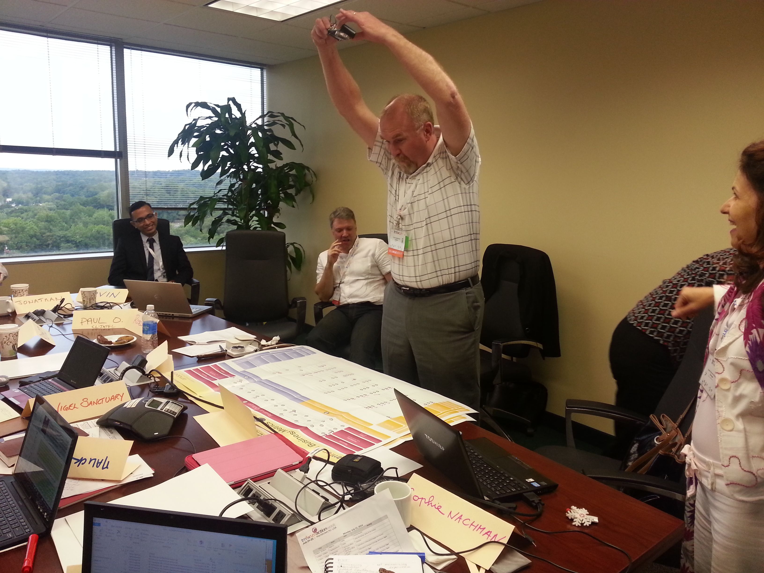
Quote
“Put the poster on the floor”

Slide 51
Project Title
 | One sentence: Build a GUI that creates a crowdsourcing effort to document, mature, approve and publish metrics.
 | Increase direct visibility into the project, increase number of work-stream members, progress on meta-data attributes of metrics
 | Great participation in metrics fest, full review of meta-data attributes, initial creation of user stories for GUI Passionate discussion and new direction for Benchmarking as a critical service from TM Forum
Project
Objectives
Action Week Objectives
Accomplishment

Slide 52
Top 3 Fx Deliverables
 | Deliverable | Delivery Date
1 | Approved User Stories | 8-21-14
2 | Gap analysis of new website design as applies to process of maturing and approving metrics | 9-1
3 | Review GUI mock ups with Josh Goldfein | 8-21
 | Cross TM Forum input to determine next steps for Benchmarking
Additional help needed?

Slide 53
Revenue Management Charging & Billing (C&B) Two Minute Synopsis
Johannes Minnaar& Rebecca Sendel
July 24, 2014

Slide 54
Quote
“Worries go down better with soup”

Slide 55
RM - Charging & Billing (C&B)
 | Adapt Revenue Management Domain to handle the challenges of various business models & partnerships
 | Review/Finalize Evolve C&B Entities for more complex customer accounts (BA) Review of Billing Open Digital Rest API NFV Catalyst with C&B (Revenue) Hybrid Customer – challenges
 | Converging of BA & CAB contributions (reviewed) OD API e2e Business Scenario and UC extended (SM & Onboarding) Catalyst referenced in NFV (requests to document revenue management in overview slide) Hybrid Customer – reviewed
Project
Objectives
Action Week Objectives
Where do you need help?

Slide 56
Fraud Management AW WRAP UP
Raul Azevedo
July 21, 2014

Slide 57
Quote
“This is a young team… not really a team of young’s…”
“Let’s make an How To Web Page for Fraud Maturity Model and make it easily to adopt as a thanksgiving turkey recipe in a How To website! ”

Slide 58
Fraud Management
 | Launch and analyze TMF Fraud Survey 2014; Evolve FM Maturity Model
 | Status and preview of Fraud Survey results Discuss how security and FM can work together to tackle the growing threat of hacking as a Fraud enabler and NFV and SDNs as potential new risks Present and discuss feasibility of developing Revenue@Risk forecast model within RMI Status and hands on session on FMMM
 | CSPs and vendors with good insight on Telecommunications Fraud and/or Risk Management are welcome to the project and to these sessions in particular Security and Risk Management knowledgeable people (join meeting already arranged with Security Team and Revenue Assurance) are also welcome
Project
Objectives
Action Week Objectives
Where do you need help?

Slide 59
Top 3 Deliverables
 | Deliverable | Delivery Date
1 | FMMM V2 consolidated and automated ready for final testing | 30th Sep 14
2 | Survey closed and data extracted to feed report Survey report ready by the end of the charter | 30th Sep 14 31st Oct 14
3 | Uncharted deliverables: Use cases defined to address the need to strengthen collaboration between Fraud Management and Security Define next charter scope | 8th Sep14

Slide 60
Smart Energy BaseN, Infonova, ESRI, TOA, Ericsson, University of Bermingham, Enterprise Architects as a Service
Presenter
July 21, 2014

Slide 61
Project Title
 | Continue Development of Energy Community in TMF Attract new members Market output and accomplishment
 | Review project- and member status Ignite new Catalyst for SJ Distribute work
 | Work plan and Action items Roadmap to SJ PM Structure of Project and Catalyst Lessons Learnt from prev. engagements
Project
Objectives
Action Week Objectives
Accomplishment

Slide 62
Top 3 Fx Deliverables
 | Deliverable | Delivery Date
1 | Smart Cities Conference
2 | Frameworx Mapping for Utilties (ctd.)
3 | Liason to leading industry councils
Additional help needed?

Slide 63
Revenue Assurance Participants: Tomsawyer, Mediacom, China Unicom Wedo, cVidya, Bae Systems, TeliaSonera.

Slide 64
Quote
“Sorry, in RA we are serious people without any sense of humor whatsoever.”
Anonymous

Slide 65
Revenue Assurance
 | Create, promote and divulge industry best practices, de facto standards, and knowledge for Revenue Assurance activities and practitioners
 | Moving from the What to the How Creating methodology and methods to apply the Revenue Assurance best practices Creating a relevant RA survey for 2014
 | Revision of GB941-A RA standard KPIs, and addition of new metrics that link to the RA risk and coverage models Review and preparation of RA survey for 2014
Project
Objectives
Action Week Objectives
Accomplishment

Slide 66
Top Deliverables
 | Deliverable | Delivery Date
1 | Updated GB941-A (including, risk, coverage, and cost metrics) | November 2014
2 | RA survey questionnaire for 2014 | October 2014
3
 | Always- RA experts, Marketing, Marketing & Marketing…
Additional help needed?

Slide 67
And the WINNERS are…

Slide 68
Next Action Week!
Hotel: Hotel Cascasi Miragem
City: Cascais, Portugal
Date: February 9-13 2015

Slide 69
THANK YOU!
HTTP://WWW.TMFORUM.ORG/Community
Collaboration Program Centre -> Project Workspace - > Documents -> Team Action Week -> TAW Morristown 2014 -> Wrap Up Presentations
https://collab.tmforum.org/sf/docman/do/listDocuments/projects.collaboration_program_centre/docman.root.team_action_week.taw_morristown_2014.wrap_up_presentations

